Slide 1
FHIR Care Coordination
Lloyd McKenzie
April 27, 2017

Slide 2
This presentation
Is licensed for use under the Creative Commons, specifically:
Creative Commons Attribution 3.0 Unported License
(Do with it as you wish, so long as you give credit)
Can be downloaded here:
http://gforge.hl7.org/svn/fhir/trunk/presentations/2017-04%20FHIR%20North/FHIR%20for%20Executives.pptx
Use “anonymous” and email address to logon

Slide 3

Who am I?
Name: Lloyd McKenzie
Company: Gevity
Background:
One of FHIR’s 3 initial editors
Co-chair FMG & FHIR Infrastructure
Co-chair HL7 Modeling & Methodology
Heavily involved in HL7 and healthcare exchange for last 16 years (v2, v3, CDA, etc.)
lmckenzie@gevityinc.com

Slide 4
What is “Collaborative Care”?
The coming together of multiple healthcare providers, the patient, family members, other care providers to deliver care
Decisions are made based on input from all participants
Participants remain engaged throughout the delivery process

Slide 5
FHIR’s role in collaborative care
FHIR is a data exchange standard
NOT a clinical practice standard
FHIR can enable information exchange to support care coordination
Still need to solve the “people problem”
Have to have desire to collaborate, policies that support collaboration

Slide 6

The data exchange challenges
Access to shared information
Contextual/filtered
Who’s responsible for what?
What should be done – best practices?
What are we actually going to do?
Plans & orders
Getting things done
And monitoring progress

Slide 7
What information?
Administrative | patient, organization, location, device, other registries, appointments, encounters
Clinical | observations, allergies, medications, procedures, family history, imaging, assessments
Financial | claims, billing, accounting
Ancillary | research, public health, quality metrics, decision support

Slide 8

Access management
Discovery of what a system does
Consent
Security tags

Slide 9
Sharing mechanisms
Multiple paradigms
Significant focus on REST
Flexible, current snapshot
REST
Documents
Messages
Services

Slide 10
Access to shared information
Multiple delivery mechanisms
Real-time query/services
Asynchronous messaging
Publish/subscribe
Documents (e.g. email)

Slide 11
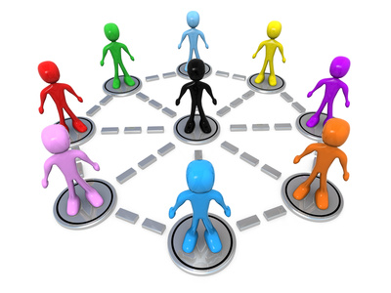
Who’s responsible for what?
Registries for Practitioner, Organization, RelatedPerson, Patient
CareTeam
Type of care
Who’s involved?
What are their responsibilities?

Slide 12
What should be done?
ActivityDefinition, PlanDefinition, Questionnaire
Order sets, protocols, clinical practice guidelines
What data should be captured?
Automated conversion from questionnaire responses into aggregatable/queryable data
Decision support operations to generate context-specific care plans

Slide 13
What will actually be done?
CarePlan and ‘Request’ resources define desired activity
Procedures/Observations
Referrals
Medication Orders/Prescriptions
Appointments
etc.
Covers Proposals, Plans and Orders
Including child orders

Slide 14

Getting things done
Multiple approaches to requesting action
Direct transmission of a “request”
Task resource
Messaging
Invoke an operation
Patterns
Definition, Request, Event

Slide 15
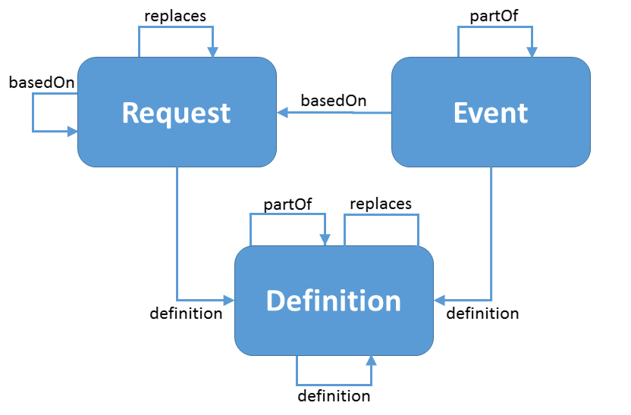
Patterns

Slide 16
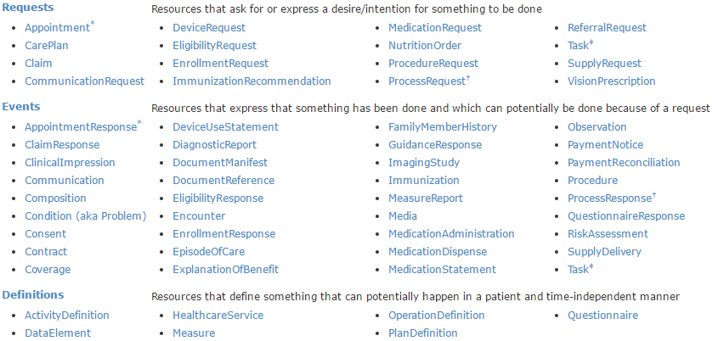
Pattern resources

Slide 17
So?
Lots of capability/flexibility
Lowering barriers to information flow enables more collaborative care
Considerable experimentation underway
Preliminary work on defining workflows within HL7
Will need agreements within community about what should be done and how

Slide 18
What’s next?
As information barriers drop, more focus on people/process issues
Will need greater engagement from:
Clinicians
Clinical regulatory bodies
Patients
Room for innovation
User interfaces
Workflows

Slide 19


Questions & Discussion?
http://hl7.org/fhir lmckenzie@gevityinc.com

